Slide 1
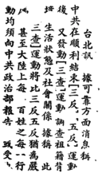
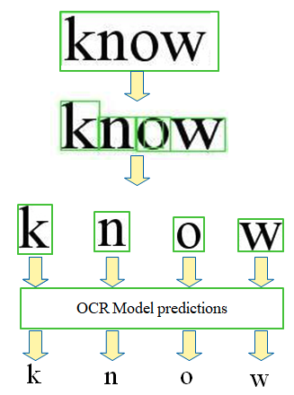
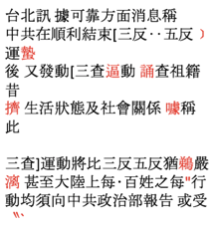
Image buckets + Unicode labels
Page Section
OCR Classifier
Unicode
Retrain new OCR model eg. (Kraken)
Unicode
Image buckets + Unicode label
X 7000 buckets

Slide 2
Machine Learning for Reading Full Form Chinese Characters in Historical NZ Newspapers
Machine Learning for Reading Full Form Chinese Characters in Historical NZ Newspapers
Preprocessing OCRD Pipeline
Preprocessing OCRD Pipeline
Singularity/Docker Pipeline
OCR-D
OCRopus
Kraken
Tesseract
NZCGMJ
Issue
≈ç
≈
≈
Deskewing
- Normalisation and Binarisation
- Split paper into sections [body,
heading, subheading]
Perform OCR on sections
Decode METS data into individual character images with corresponding label
Store in cloud storage

Slide 3
Machine Learning for Reading Full Form Chinese Characters in Historical NZ Newspapers
Unsupervised Learning for Clustering Analysis
Encoder
Decoder
Images with Unicode labels
Compressed Representation
Reconstructed Images
Deciding K
1. Seed from class labels
2. Affinity Propagation
Retrain weights
OCR LTSM Classifier
Class labels
Cluster labels
Fix label
1. Google Tesseract
2. OCR
Confusion Matrix
K-means Clustering
Human Correction
Error Prioritisation
1. Largest pairs first
2. ..
New/different
label/cluster
Retraining classifier loop
Retraining cluster loop

Slide 4
Document
Digitisation
Preprocessing
Segmentation
Feature Extraction
Classification
Recognised Text
「四五六月份 何游市进长期冷決特光光打破空市九华
丹衣頓茶價市情,阻来未北的。一般来田人士所
詩曰:「滿国瓜葉綠半半,一
二,来市場所冷淡情境的理由有三
辅花来值二城,市人只知来自長,
由於現在非因进多,互相选中
数问心對農博。」
Image Processing
Creating Image Buckets
Page Image
Noise Removal
Perspective Transform
Character Detection
Character Classification
Character Extraction
(本刊特訊)本超星崙坤屋崙非传會所,自去年五月廿七日開非
,迄今睛又週年,由於該會所之創立旨在團結故埠僑胞,宣揚
國文化,並計劃故立華文學校,加深我偽認識祖國之偉大,藉
情独我僑之要國家建民族之精神,尤去注重興輯我传胞之各種
利事業。故自成立以来先後加入核會為會員者,為數甚架,成
故合所乃不可多得為專械典韓僑胞福利事業之特有機構,其
之宏偉,故備之完善,除充滿祖國文化氣氛外,堪稱美觀實用兼
年備,因此不斷推致中西各界人士讚頌。
拔會所全性企人,為慶祝協會所成立一週年紀念,並酬
念各孙悟胞壁友邦人士支持贊助之意,特仿照去年開幕
法,敦請林坤大同國樂研究社 公演繹致身劇,藉以助慶而娛
批大同社斯加強陣容,擴大組織,提高技藝,除不斷排練,
製戲服及道具,配素,燈光等,並揀選精教節目表演外,特
名伶垂青樂名家多位大員莊臨屋坪,聯合故社拍演,查故
可由港啟程飛組境星埠,計有享譽港九之 春站旦事艷梅
雨小姐。「仙耳鳴」班之音樂名宿字扳師傅李蘇,梵药聖手朱慶祥兩
生親自領導流表。又悲故社是次預演粵劇共有四套,均為我南中國編劇
名家唐湘生先生之遺作,而放四套劇本更「仙鳳鳴」及「新能勝」(
印芳艷芬班)之戲寶。劇名為:e「帝女花」「牡丹亭驚夢」「犬
網梵宮十四年」回「胭脂巷口故人來」等。均係描寫我國歷史故事,壯
念各孙悟胞壁友邦人士支持贊助之意,特仿照去年開幕
法,敦請林坤大同國樂研究社 公演繹致身劇,藉以助慶而娛
批大同社斯加強陣容,擴大組織,提高技藝,除不斷排練,
製戲服及道具,配素,燈光等,並揀選精教節目表演外,特
敦請林坤大同國樂研究社 公演繹致身劇,藉以助慶而娛
批大同社斯加強陣容,擴大組織,提高技藝,除不斷排練,
製戲服及道具,配素,燈光等,並揀選精教節目表演外,特
名伶垂青樂名家多位大員莊臨屋坪,聯合故社拍演,查故
可由港啟程飛組境星埠,計有享譽港九之 春站旦事艷梅
雨小姐。「仙耳鳴」班之音樂名宿字扳師傅李蘇,梵药聖手朱慶祥兩
生親自領導流表。又悲故社是次預演粵劇共有四套,均為我南中國編劇
名家唐湘生先生之遺作,而放四套劇本更「仙鳳鳴」及「新能勝
利事業。故自成立以来先後加入核會為會員者,為數甚架,成
故合所乃不可多得為專械典韓僑胞福利事業之特有機構,其
上
乘

Slide 6
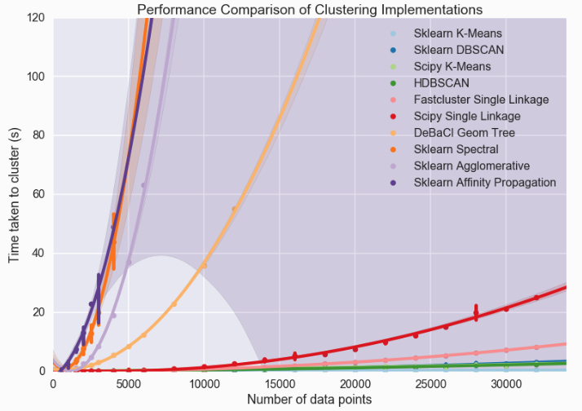
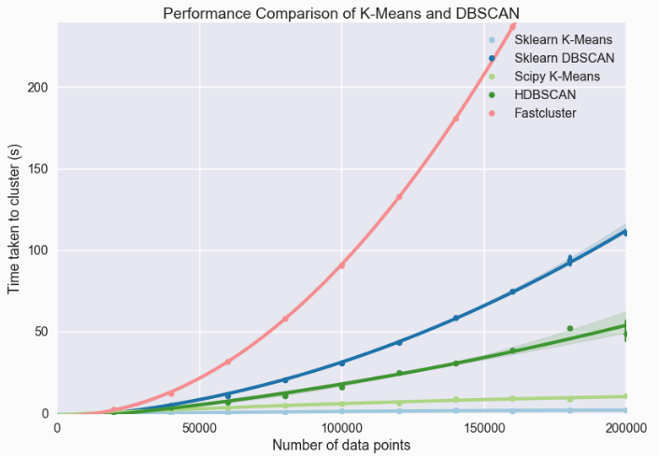
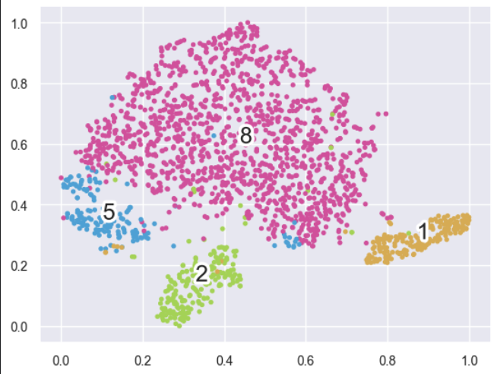
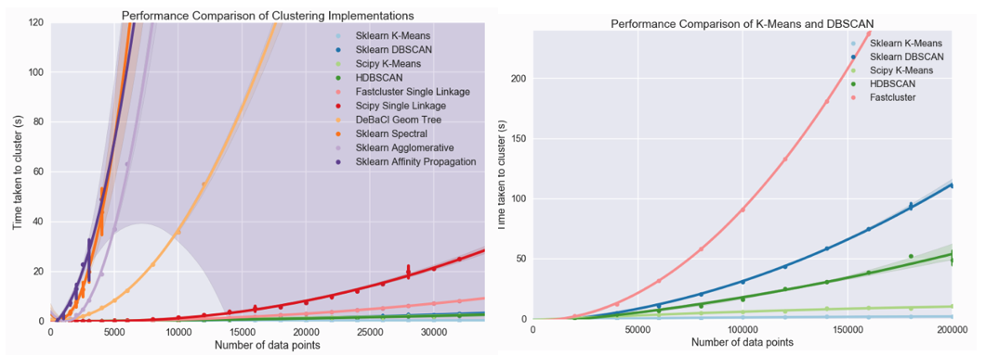
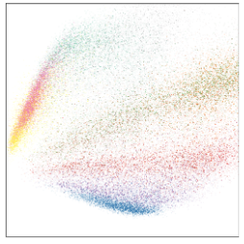
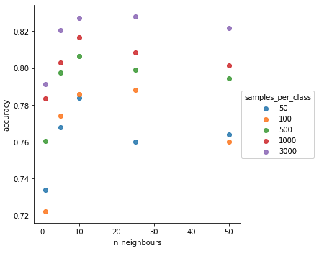
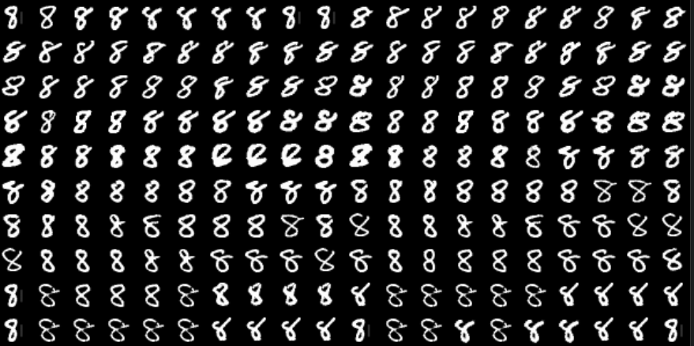
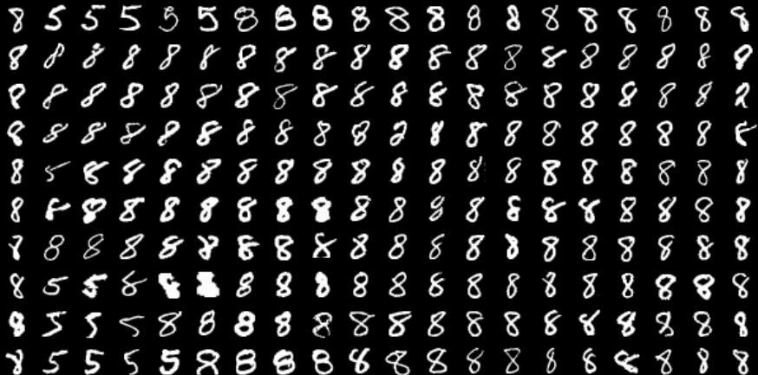
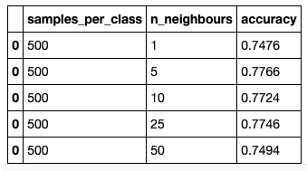
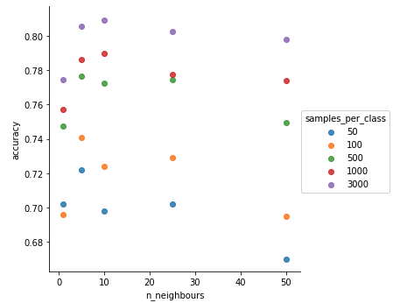
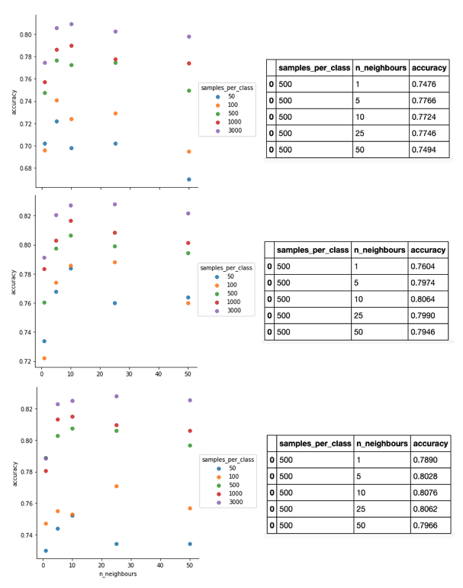
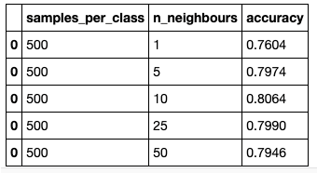
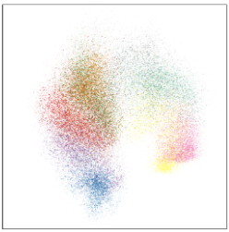
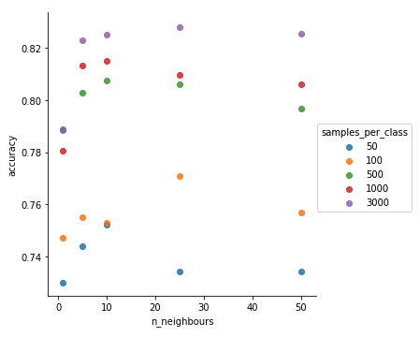
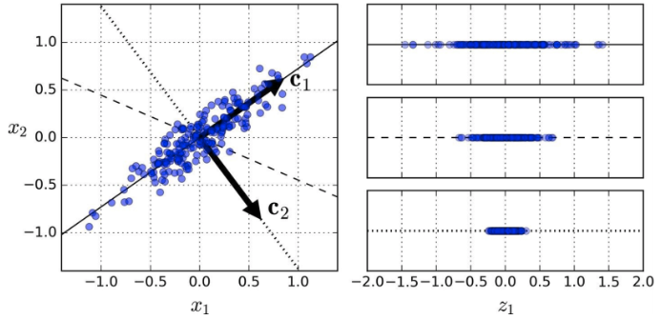
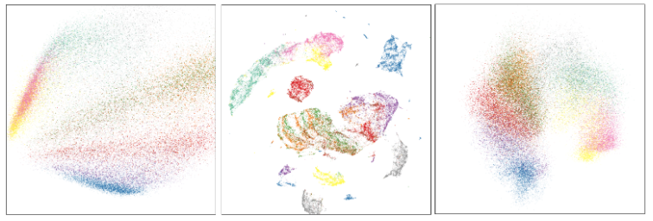
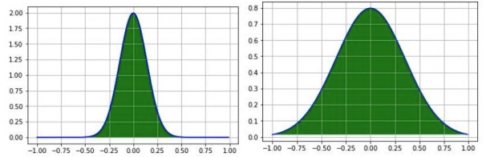
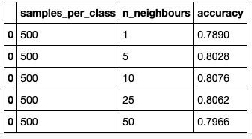
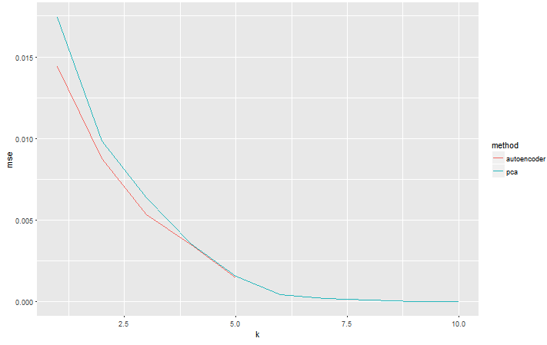
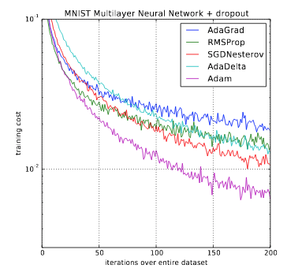

Slide 7
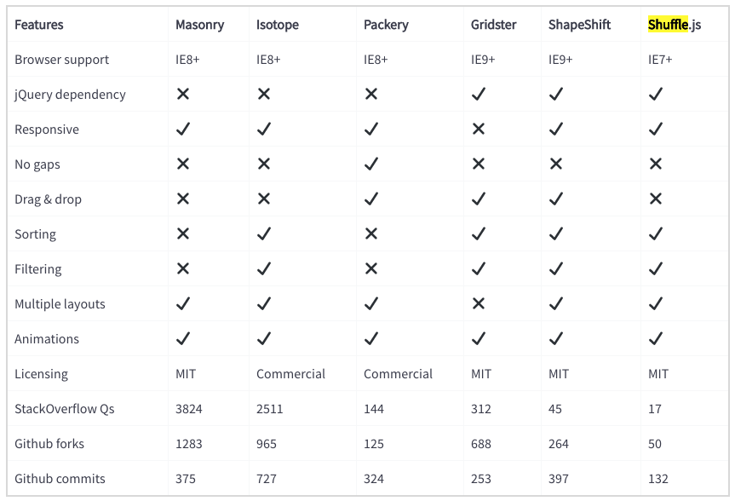
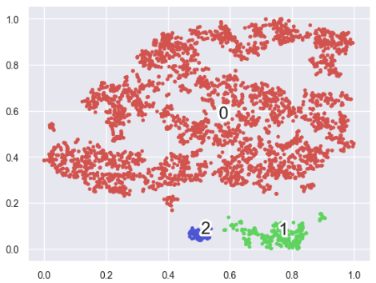
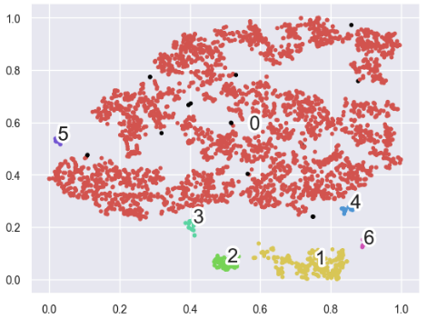
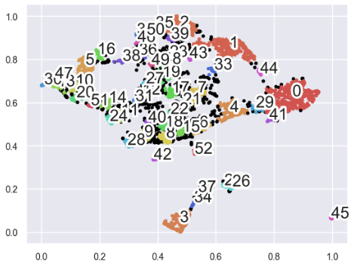
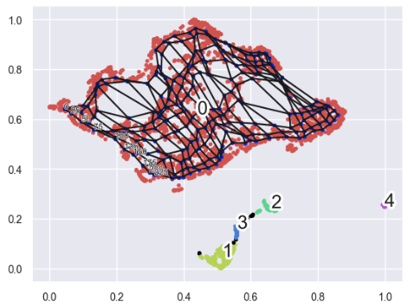
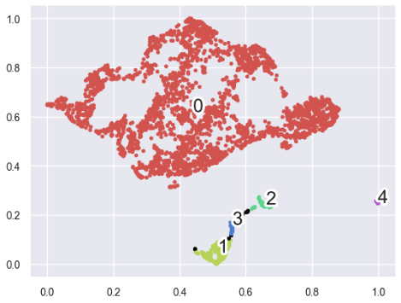
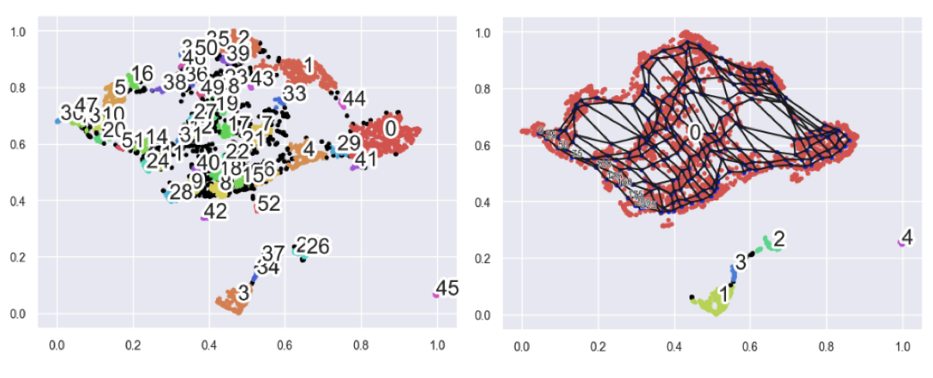

Slide 8
Encoder
Decoder
Images with Unicode labels
Compressed Representation
Reconstructed Images
Deciding K
1. Seed from class labels
2. Affinity Propagation
Retrain weights
OCR LTSM Classifier
Class labels
Cluster labels
Fix label
1. Google Tesseract
2. OCR
Confusion Matrix
K-means Clustering
Human Correction
Error Prioritisation
1. Largest pairs first
2. ..
New/different
label/cluster
Retraining classifier loop
Retraining cluster loop

Slide 9
DataLoader
SummaryWriter
torch.nn.Module
AutoEncoder
+encoder
+decoder
+device
+_init_weights
+tb
+job
+__init__(tb=None, job=None)
+__repr__()
+forward(batch)
+gen_tb(output_dir, lr, batch_size)
+fit(dataset, batch_size, max_epochs, lr, opt='Adam', loss='BCE', patience=0,
eval=True, plt_imgs=None, scatter_plt=None, pltshow=False, output_dir=’’,
save_model=False)
+eval_model(self, dataset, plt_imgs=None, scatter_plt=None, pltshow=False, output_dir=’’)
+save_model(self, dataset, output_dir)
+ load_model(self, output_dir)
+_mkdirs(dir_name)
+_init_weights(layer)
EarlyStopping
+mode
+tol
+patience
+best
+num_bad_epochs
+_init_Is_better(mode, tol, percentage)
+step
+_init_is_better(mode, tol, percentage)

Slide 10
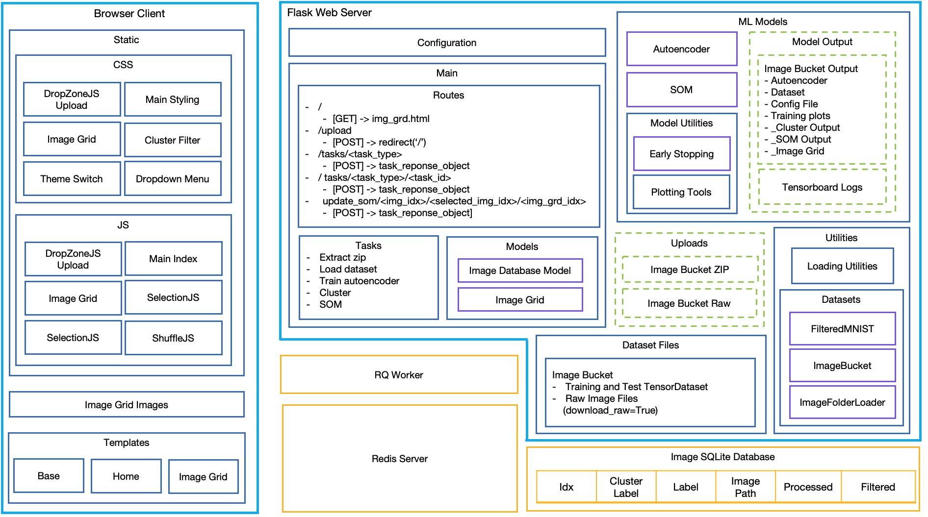
Browser Client
Flask Web Server
ML Models
Static
Configuration
Autoencoder
Model Output
CSS
Main
Image Bucket Output
- Autoencoder
- Dataset
- Config File
- Training plots
- _Cluster Output
- _SOM Output
- _Image Grid
DropZoneJS Upload
Main Styling
SOM
Routes
/
[GET] -> img_grd.html
/upload
[POST] -> redirect(‘/’)
/tasks/<task_type>
[POST] -> task_reponse_object
/ tasks/<task_type>/<task_id>
[POST] -> task_reponse_object
update_som/<img_idx>/<selected_img_idx>/<img_grd_idx>
[POST] -> task_reponse_object]
Image Grid
Cluster Filter
Model Utilities
Early Stopping
Theme Switch
Dropdown Menu
Tensorboard Logs
Plotting Tools
JS
Tasks
Extract zip
Load dataset
Train autoencoder
Cluster
SOM
Models
Uploads
Utilities
DropZoneJS Upload
Main Index
Loading Utilities
Image Database Model
Image Bucket ZIP
Image Grid
SelectionJS
Image Grid
Image Bucket Raw
Datasets
SelectionJS
ShuffleJS
FilteredMNIST
Dataset Files
RQ Worker
Image Bucket
Training and Test TensorDataset
Raw Image Files
(download_raw=True)
ImageBucket
Image Grid Images
ImageFolderLoader
Redis Server
Templates
Image SQLite Database
Base
Home
Image Grid
Idx | Cluster Label | Label | Image Path | Processed | Filtered

Slide 11
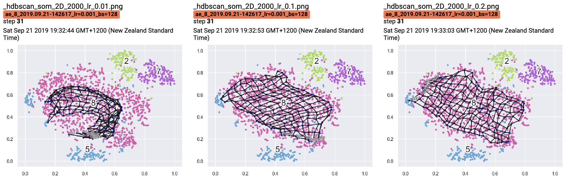
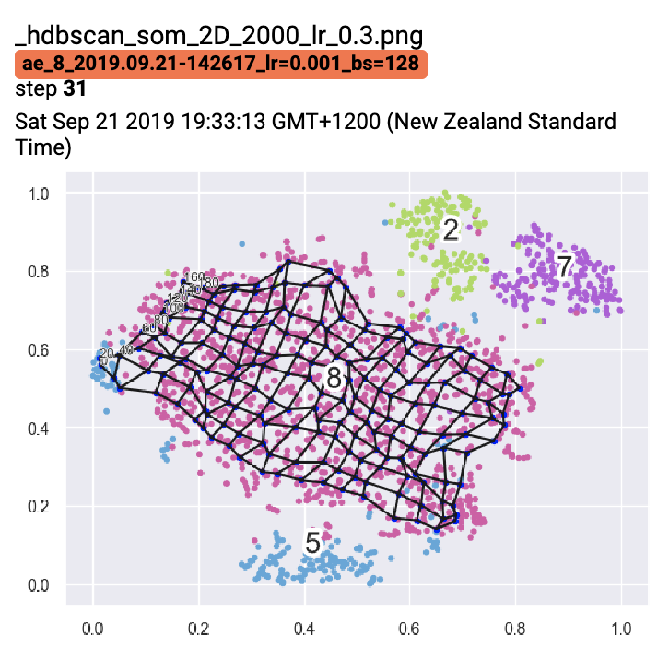
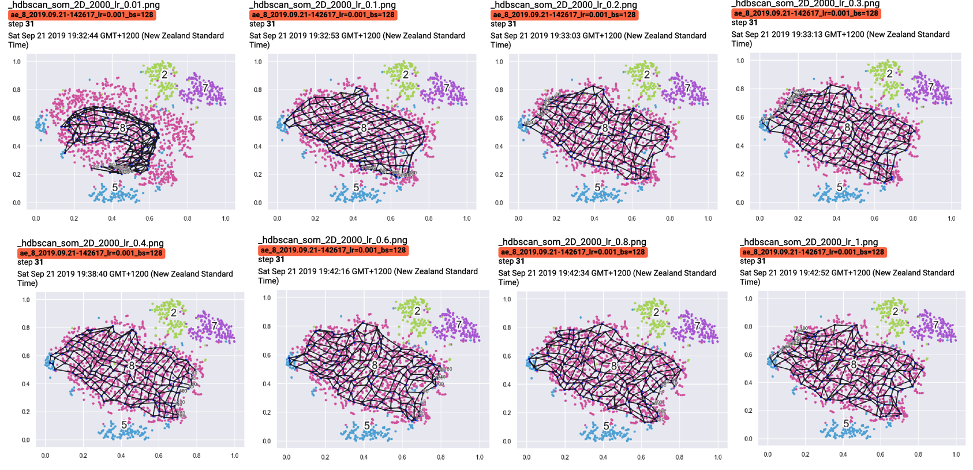
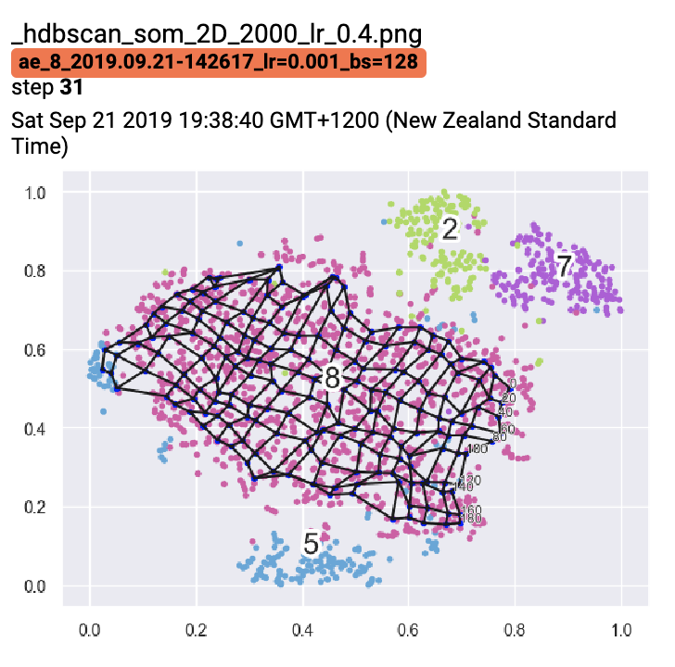
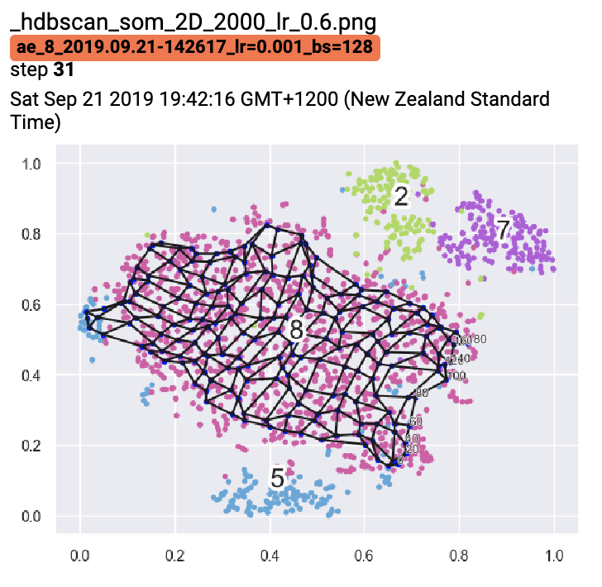
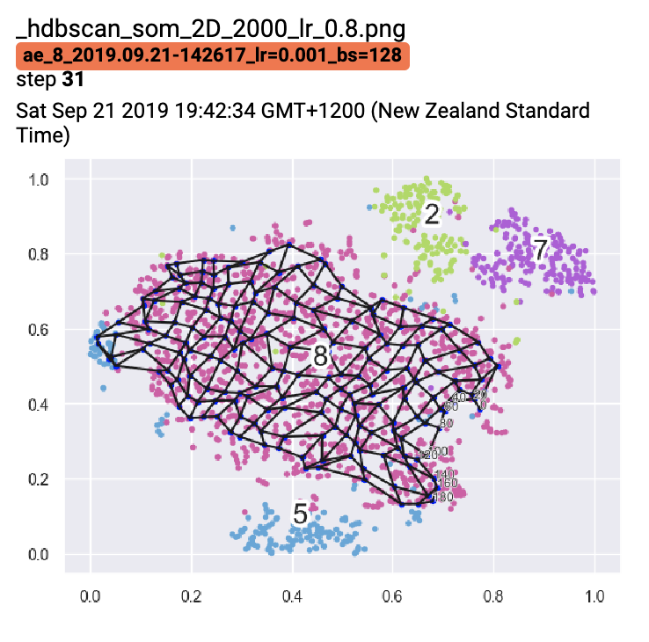


Slide 12
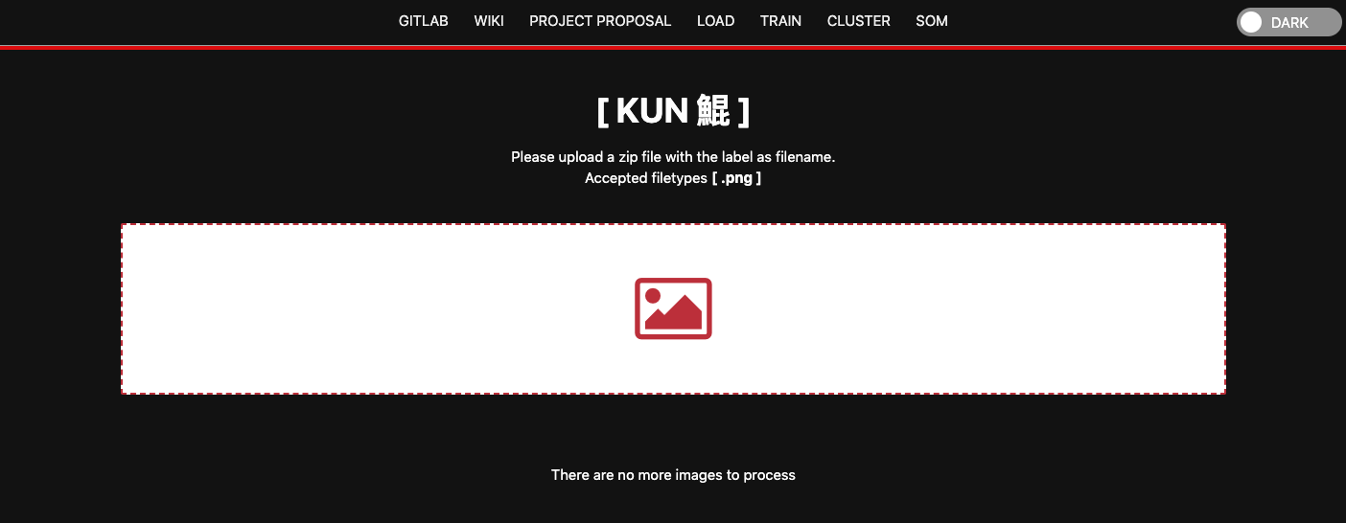
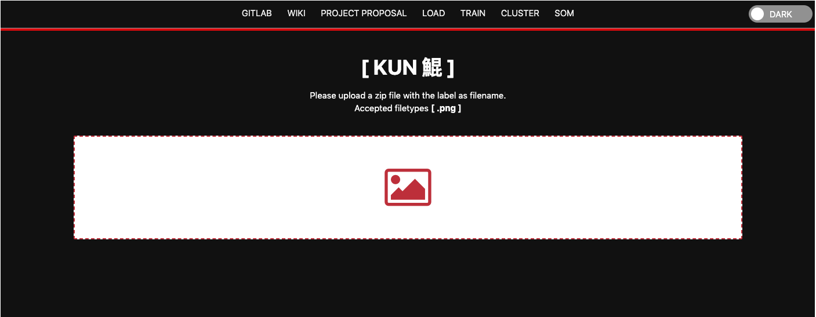

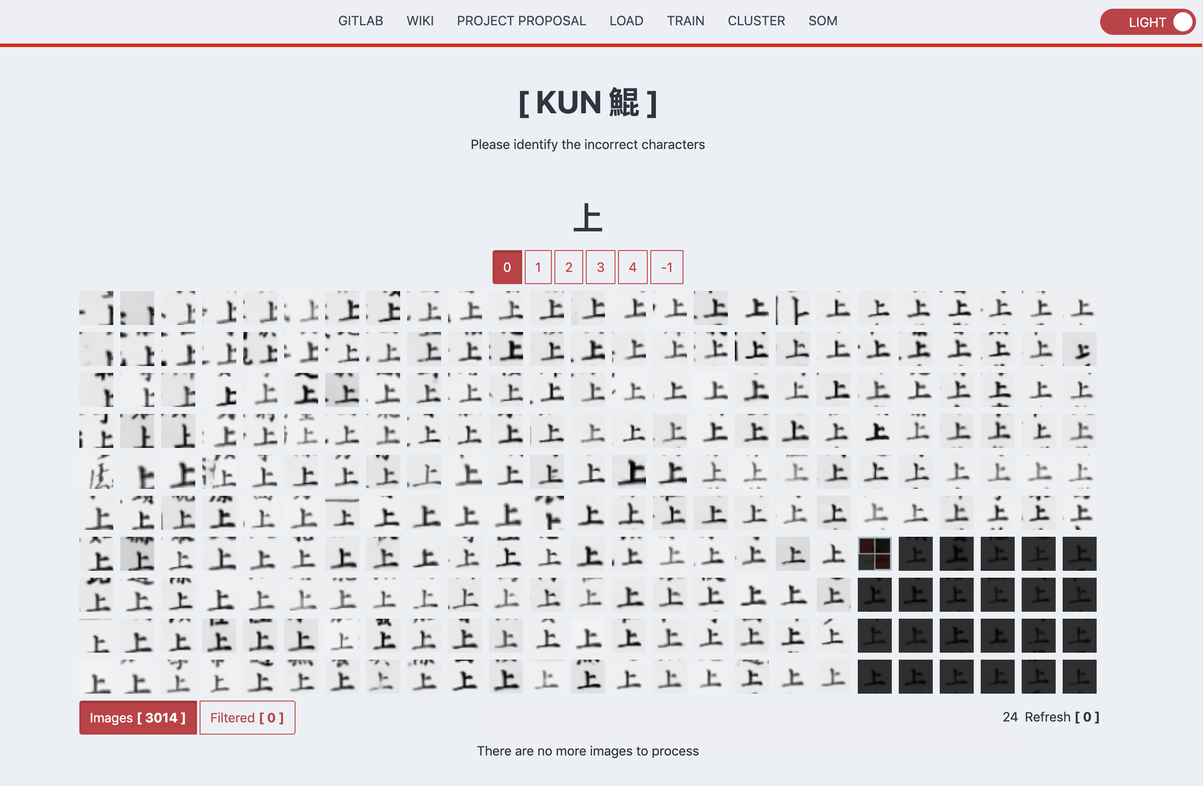

Slide 13
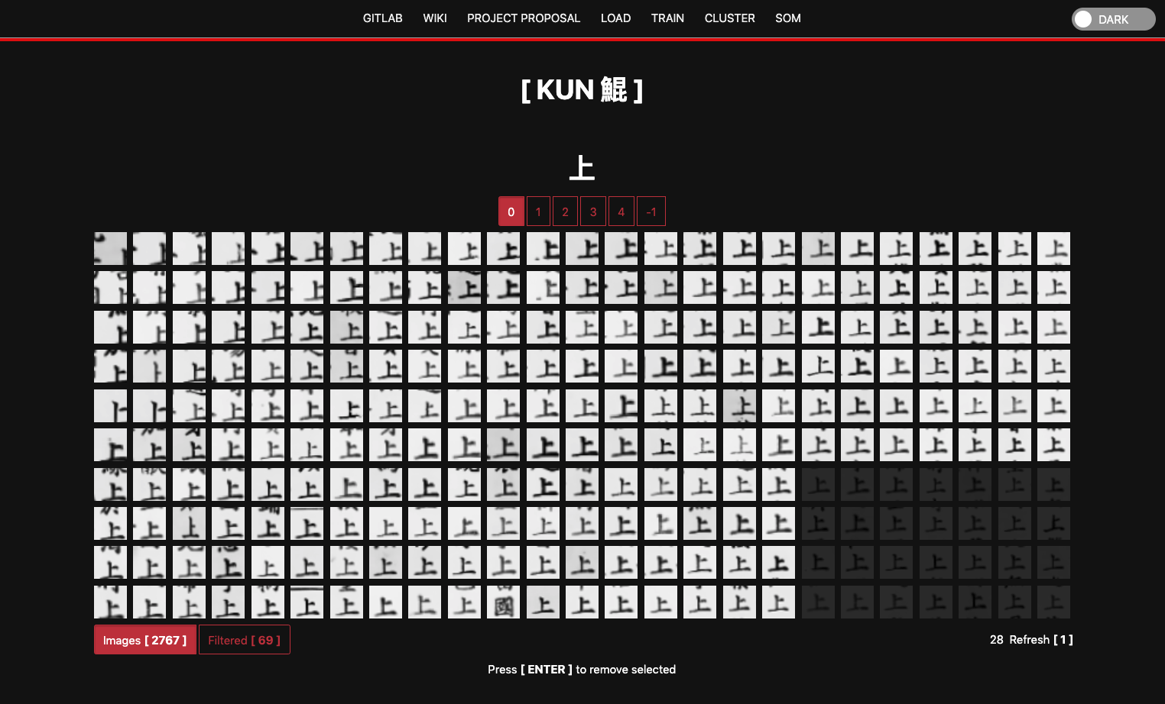
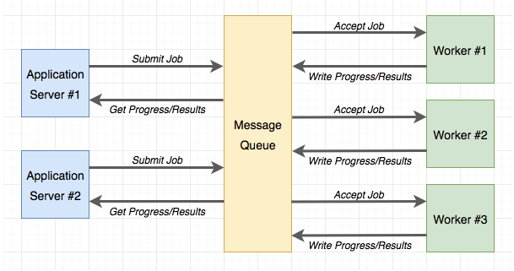
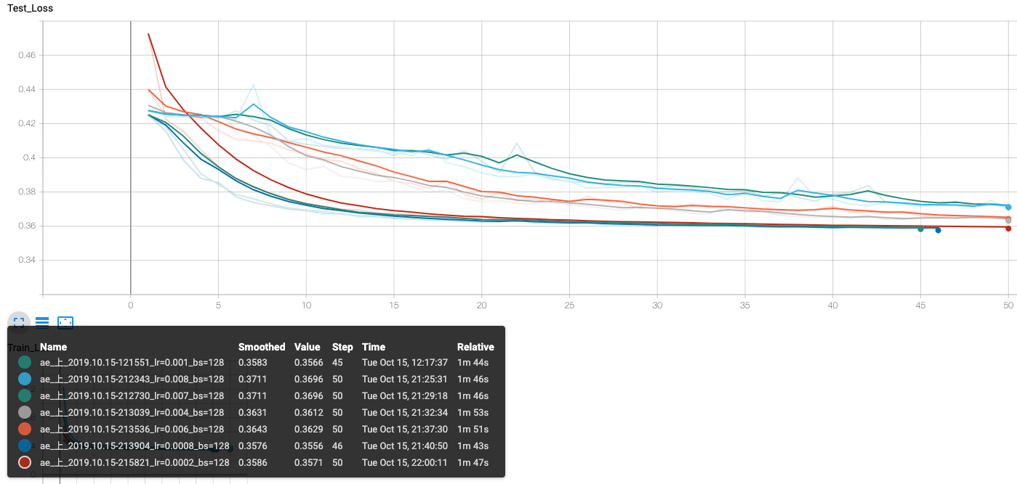
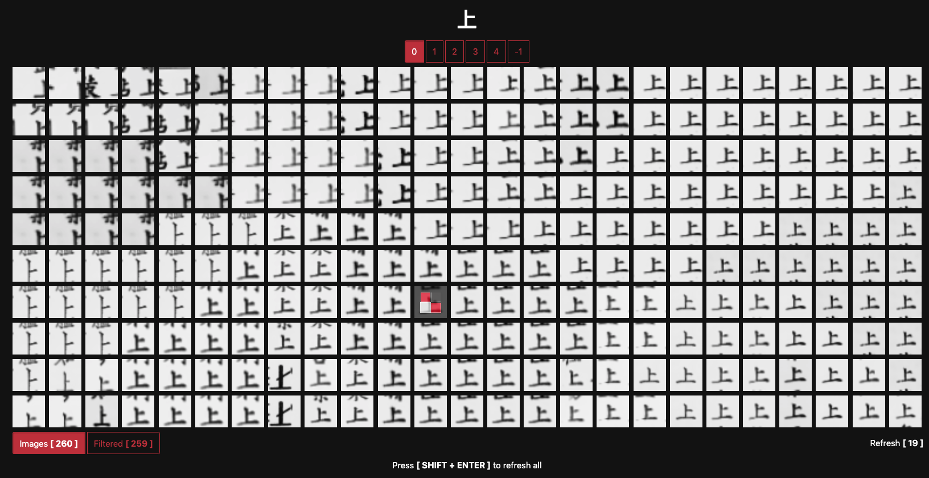
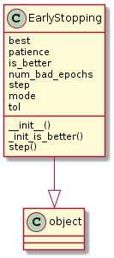
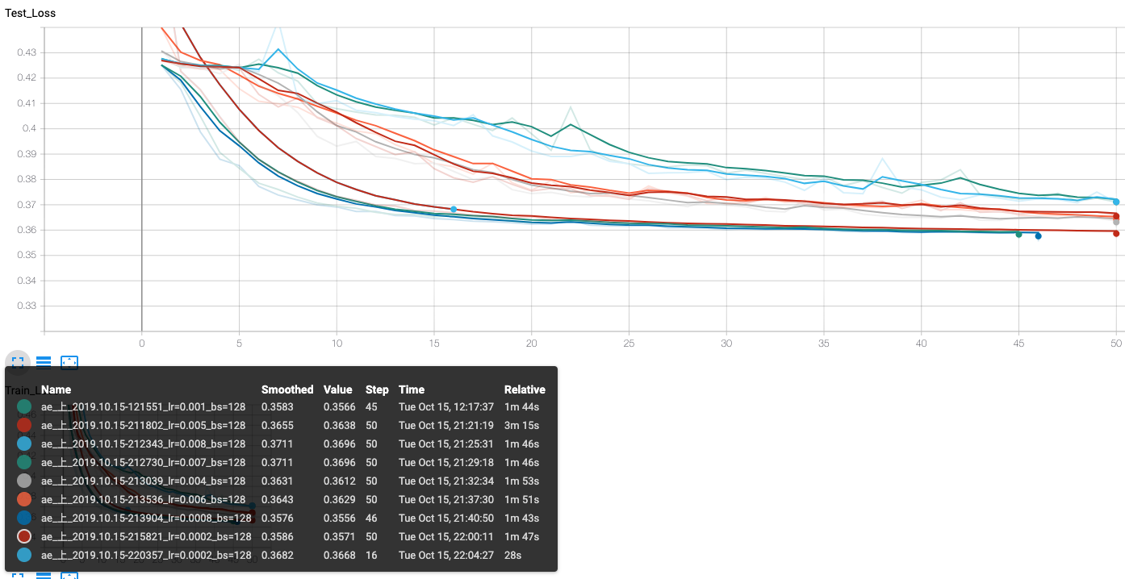
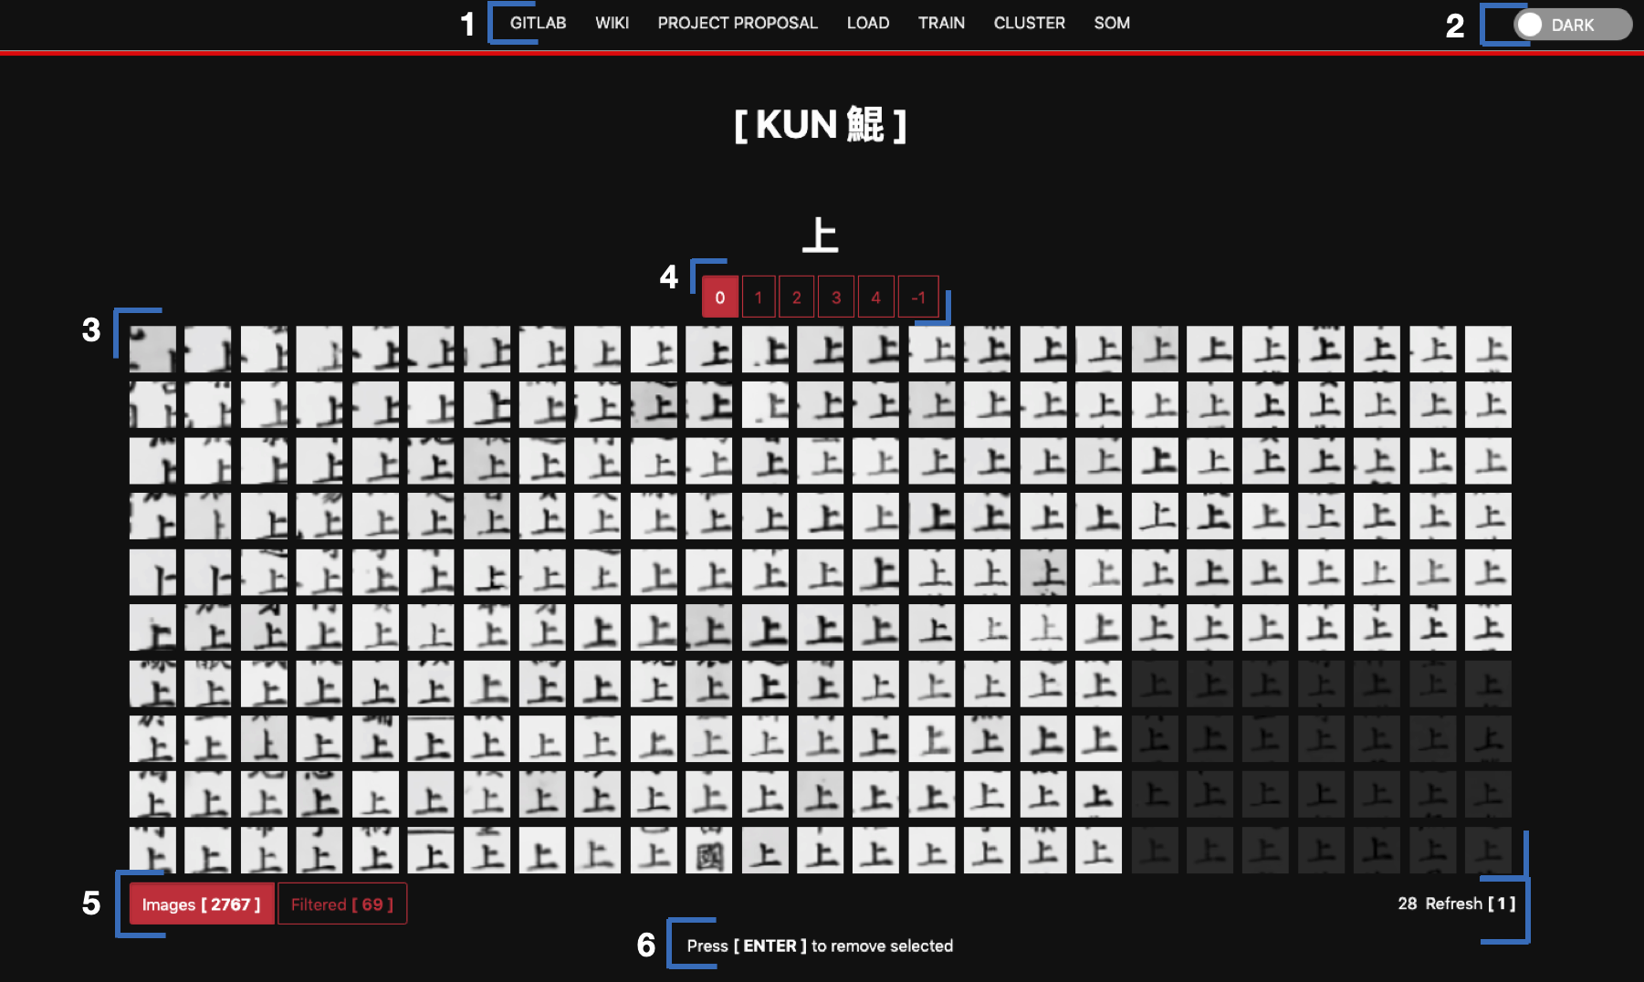
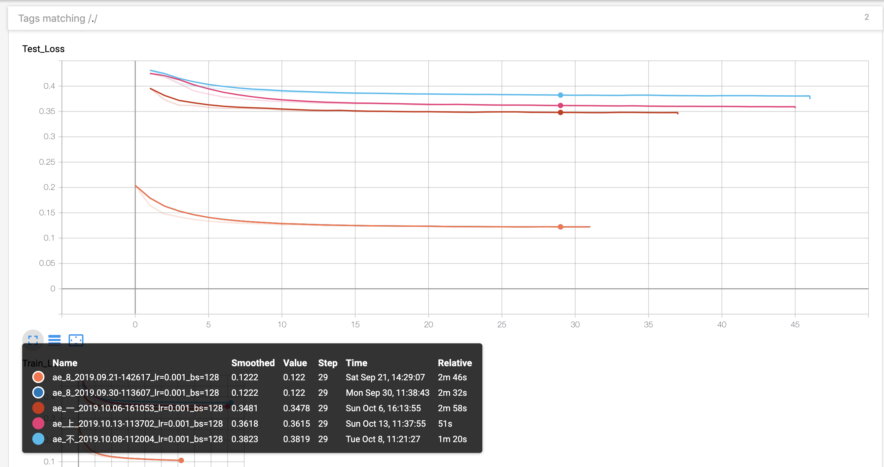
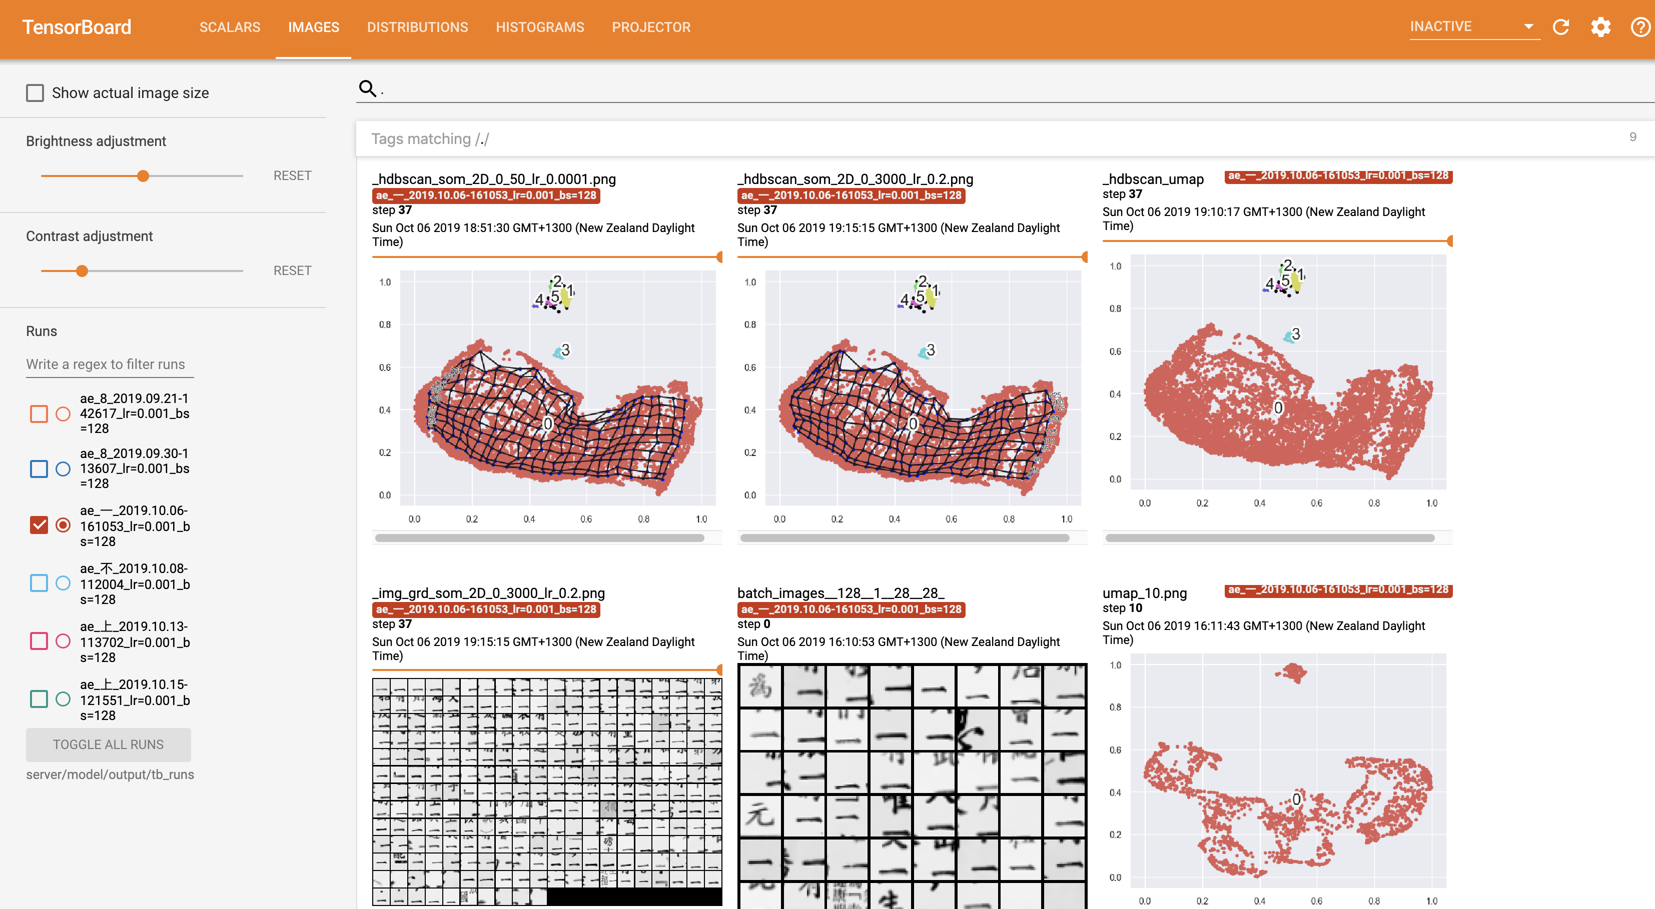
1
2
Configuration
User
4
3
5
6

Slide 14
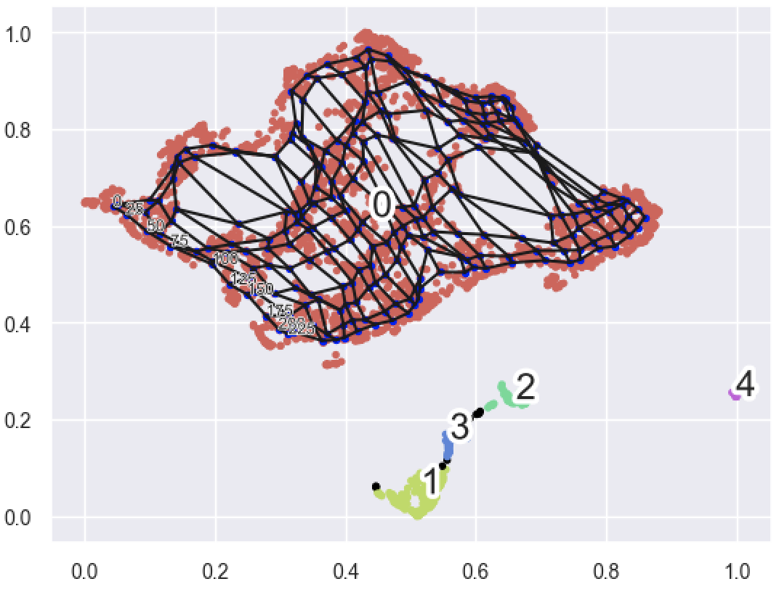








_hdbscan_som_2D_0_refresh=20_iter=500_lr=0.1

Slide 15











User uploads zipped image bucket
Uploaded Files
User uploads zipped image bucket

Slide 17






Slide 18
Routes
/ [GET] -> img_grd.html
/upload [POST] -> redirect(‘/’)
/tasks/<task_type> [POST] -> task_reponse_object
Extract Zip
Load Data
Train Autoencoder
Cluster
SOM
New
Refresh
Switch
Filtered
/ tasks/<task_type>/<task_id> [POST] -> task_reponse_object
<task_type> and task_status != finished
Report job progrss
<task_type> and task_status = finished
Load next task
update_som/<img_idx>/<selected_img_idx>/<img_grd_idx>
ae_<label>_<timestamp>.pth
Img_bucket.pt
config.json
training_plots_<epoch>.png
_hdbscan_umap.png
_hdbscan_som_2D_<c_label>_<refresh>_<ite>_<lr>.png

Slide 19
Noise Removal
Text Separation
Page Image
Bilateral filter
Canny edge detector
Find border contours
Perspective transform
Binarisation
Canny edge detector
Rank filter to remove inner borders
Dilation
Removing page border and deskewing
Enhancing text regions
Segmentation
Adaptive thresholding
Find bounding boxes of contours
Merge overlapping bounding boxes
Crop bounding boxes
Layout Analysis
Extracting segments

Slide 21

Machine Learning for Reading Full Form Chinese Characters in Historical NZ Newspapers
Unsupervised Learning for Clustering Analysis
Encoder
Images with Unicode labels
Compressed Representation
Reduce to 2 dimensions
Clustering
Fix label
Self Organising Map
Human Correction
Correction loop
New/different
label/cluster
Cluster loop
Image grid

